Slide 1
IOT in AG-Tech (AgricultureTechnology)
Presented By:
Manpreet Singh
Ankit Tripathi
Gaurav Taneja
Gaurav Chajjed

Slide 2
What is IOT
Internet of things is different from Internet. Internet of things is a smart way of communication and exchange of data between the object of the network. Internet of things collects information about these objects which helps in making decision and analyzing.
Vehicles, Security cameras, sensors and software are some example of the objects that are connected to internet and identify themselves to other objects or devices.

Slide 3
Benefits
Better decision are made when there is more data.
Monitoring and maintaining things.
Less workload due automation.
Saves money and increases efficiency.
Better quality of life.
Link: https://medium.com/zeux/the-internet-of-things-iot-5-reasons-why-the-world-needs-it-125fe71195cc

Slide 4
Role of IoT in Agriculture
IoT help in measuring all kinds of data remotely and provide this information to the famers in real time.
Helps in maintain soil moisture, chemical application, dam levels
Monitor fences, vehicles and weather.
Monitoring these farm operation and performance allows famer to make decision that can improve farm productivity and yield.

Slide 5
INTRODUCTION
The Internet of things is a revolutionary technology that has the capability to transform any industry including the agriculture sector. As the population is increasing and it is expected to surpass the 9 billion mark by 2050, the demand for the food will increase and hence the production of food needs to be optimised to fulfill the future demand.
Currently, most of the IOT devices are deployed in a controlled environment such as polyhouses and greenhouses. IoT can be used to produce the best quality produce by controlling the factors which can be controlled by humans like the soil pH, soil moisture, temperature, humidity, rate of application of nutrients. While harvesting, IoT can be used to automate the grading and packing system with proper identification and tracking.

Slide 6
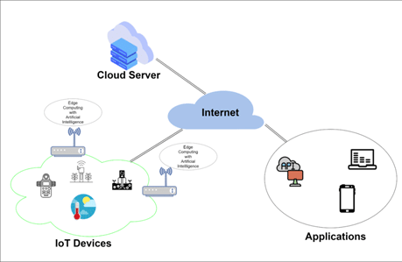
Architecture
Link: https://www.researchgate.net/figure/The-basic-architecture-of-precision-farming_fig5_348164997

Slide 7
Smart Farming
Aim:
Smart farming is a series of strategies and tools that allows a farmer to optimise and increase the soil quality and productivity.
Stages :
Data Collection
Analysis of data
Decision making based on analyzed data
Managing field operations based on analyzed data

Slide 8
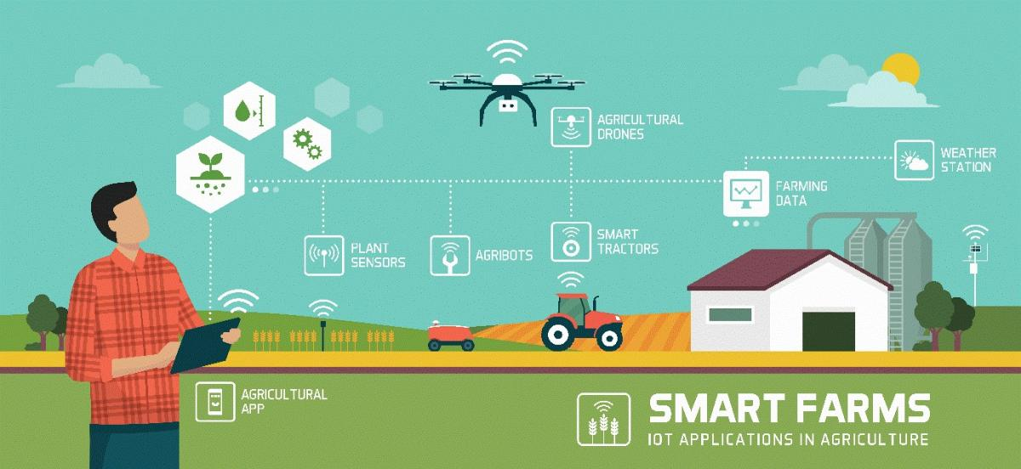
Smart Farming Management System

Slide 9
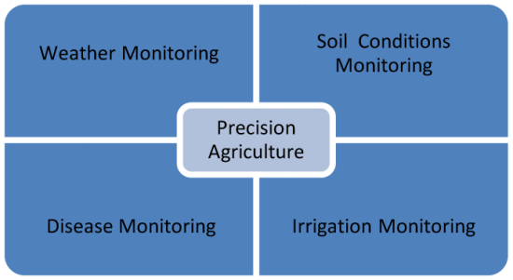
Smart Farming Management System is an organisational software that collects data and recordings from the sensors and organises the data.
Responsibilities of SFMS:
Predictive Analysis
Sensing and Monitoring
Weather Monitoring
Crop Scouting
Disease/Infection Detection

Slide 10
Components
Sensors
Control Systems
Network
Cloud Storage
Application Interface

Slide 11
Sensors
Sensors and Actuators are the building blocks in the architecture of IOT in agriculture. Sensors are used to record the real time values of factors like temperature, humidity, pressure, Co2 and soil etc.
Types of Sensors:
Temperature
Pressure
Humidity
Imaging
Gas
Level

Slide 12
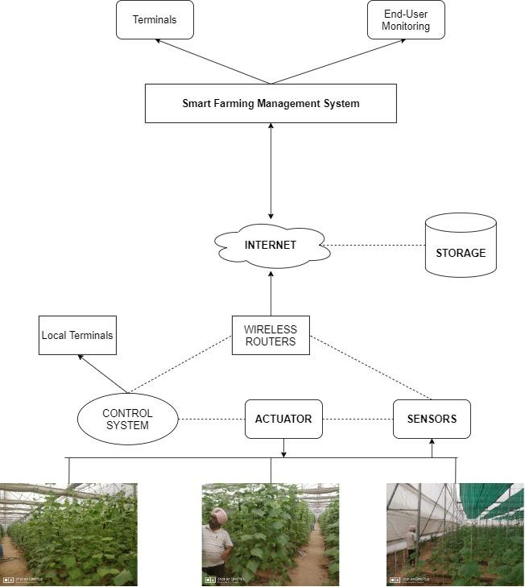
Architecture

Slide 13
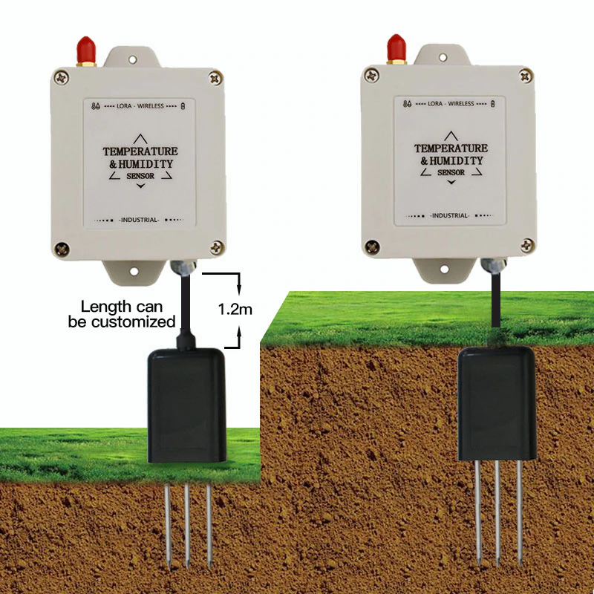
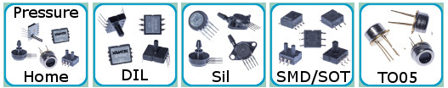
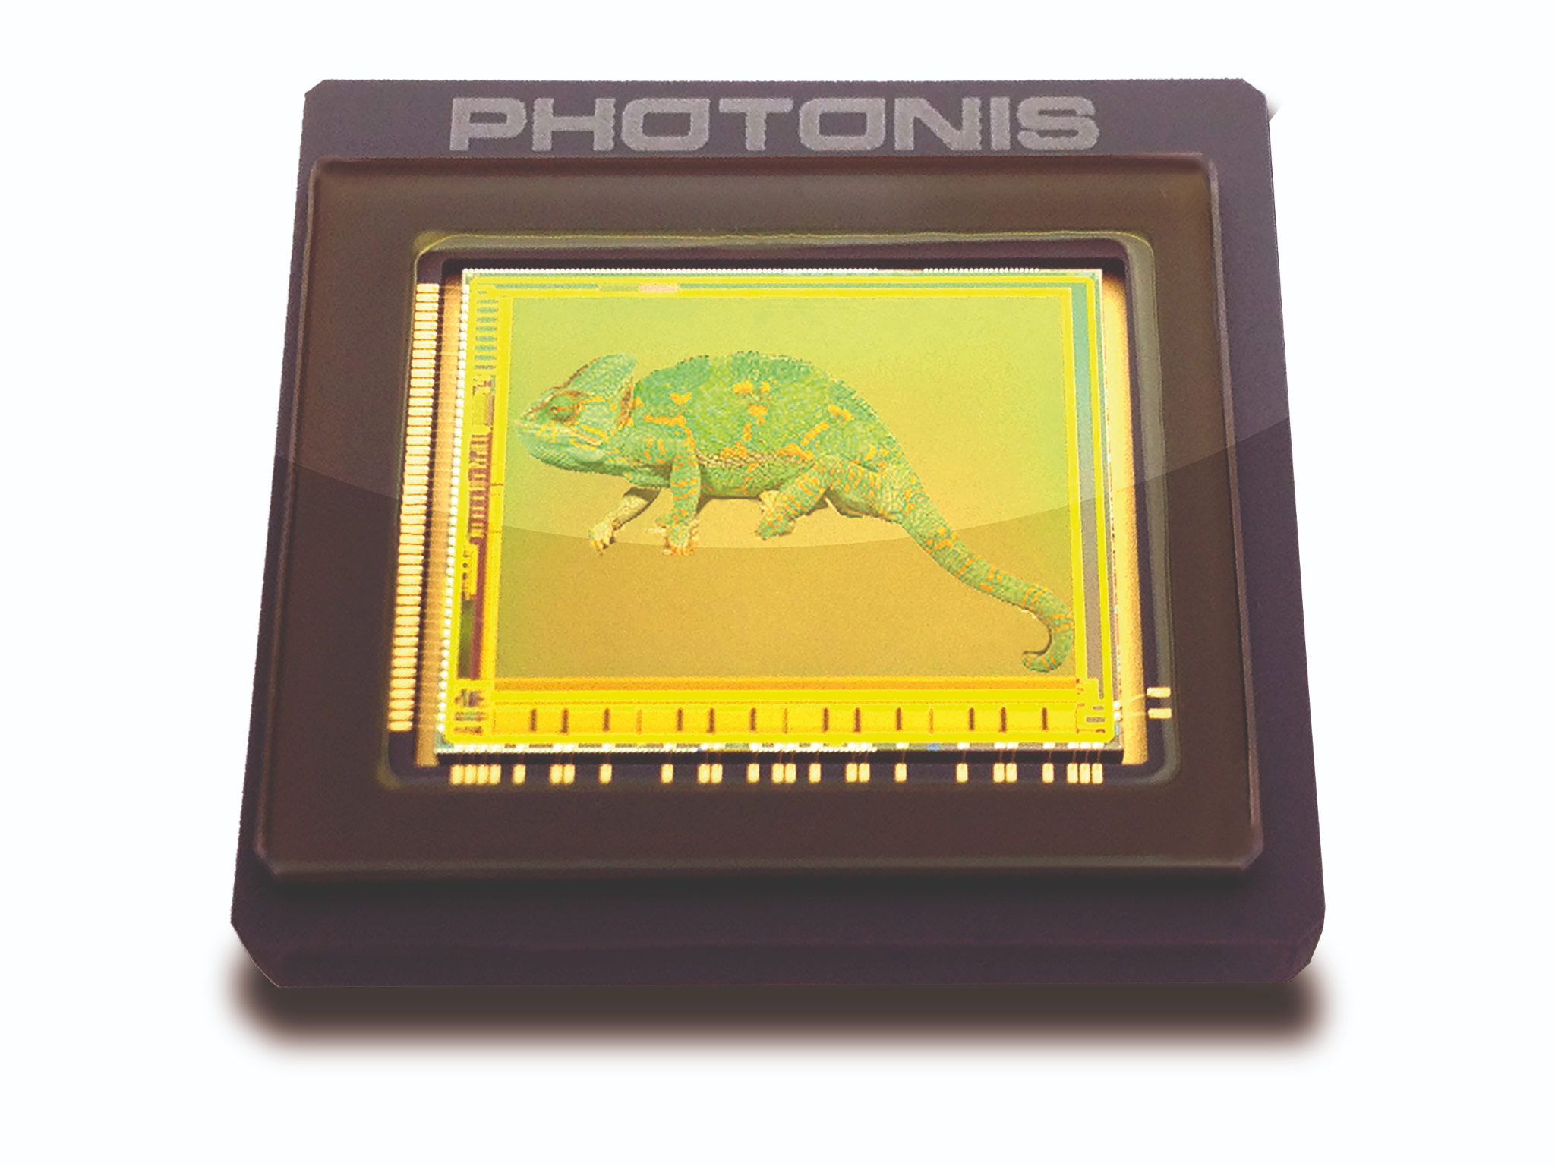
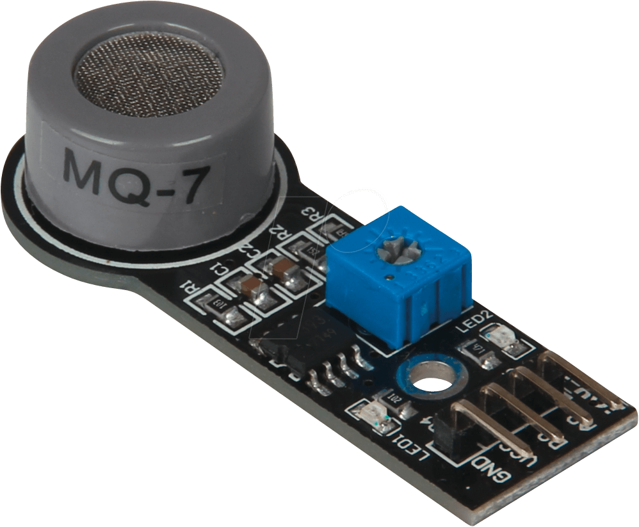
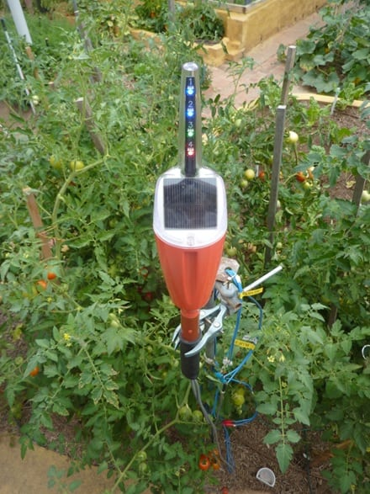
Pressure
Temperature and Humidity
Image Sensor
Gas Sensor
Soil Moisture Sensor

Slide 14
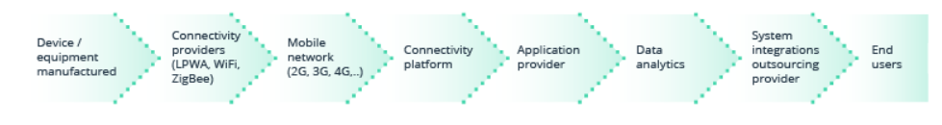
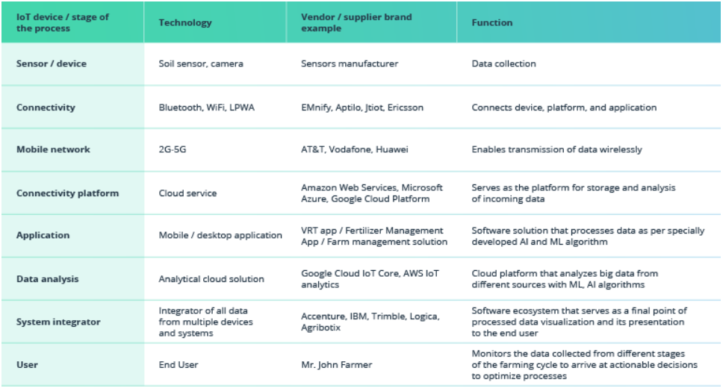
Network and Control System

Slide 15
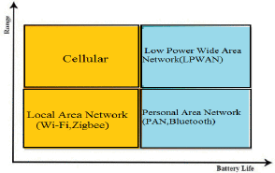
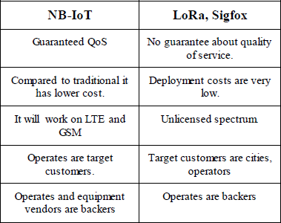
LPWAN: Low powered Wide Area Network
Types of LPWAN:
NB-IOT
LoRaWAN
Sig-Fox

Slide 16
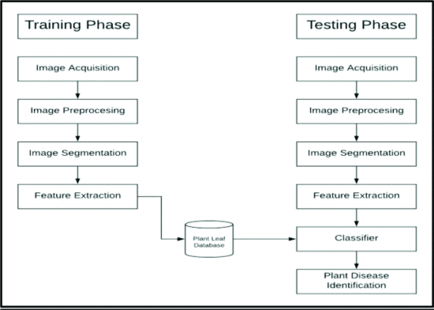
Storage
Leaf Disease Detection process

Slide 17
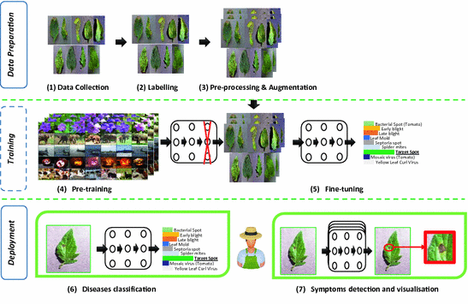

Slide 18
Challenges.
High Capital Investment.
Training the Farmers.
Connectivity of all devices regardless of brand.
Security with Increasing data.

Slide 19
References
https://ieeexplore-ieee-org.ezproxy.uta.edu/document/8663998
https://ieeexplore-ieee-org.ezproxy.uta.edu/document/8597264
https://ieeexplore-ieee-org.ezproxy.uta.edu/document/8030481
https://ieeexplore-ieee-org.ezproxy.uta.edu/document/8883163
https://ieeexplore-ieee-org.ezproxy.uta.edu/document/7724508
https://ieeexplore-ieee-org.ezproxy.uta.edu/document/8869090
https://ieeexplore-ieee-org.ezproxy.uta.edu/document/6755306
https://ieeexplore-ieee-org.ezproxy.uta.edu/document/9293672
https://ieeexplore-ieee-org.ezproxy.uta.edu/document/8942686
https://ieeexplore-ieee-org.ezproxy.uta.edu/document/7587787
https://ieeexplore-ieee-org.ezproxy.uta.edu/document/9243410

